Slide 1
College Algebra Plan Updated
 | Traditional | Flipped | Adjustment Ideas
Preparation | Read Book | Read Book and Watch Video Lecture | Make videos interactive with a question slide, Concept Check?
In-Class | Lecture/Group Activities/Discussions | Concept Check/Group Activities/Discussions/Exit Ticket | More Pair Share less Desmos or find a way to combined. Desmos and Think Pair Share
Practice | Homework | Mastery Quizzes on Fridays | Good
Assessment | Chapter Exams, Final | Two writing projects | Rewrite handout and scaffold more
Please let me know If you are also going down this journey. I would be happy to collaborate with you all.
Update on new design:
Preparation: Watch video and Take notes (Lecture video will only be concepts with one applied example to illustrate “How To”
In-Class: Start with Concept Check. Then do demonstrations with Think-Pair-Revise-Share. End with Desmos, on their own practice, and an exit ticket. Need to create a better rubric for in-class work.
Practice: Weekly Friday Mastery Quizzes
Assessment: Capstone project at the end of the semester with scaffolded assignment in preparation for the final paper and presentation.

Slide 2
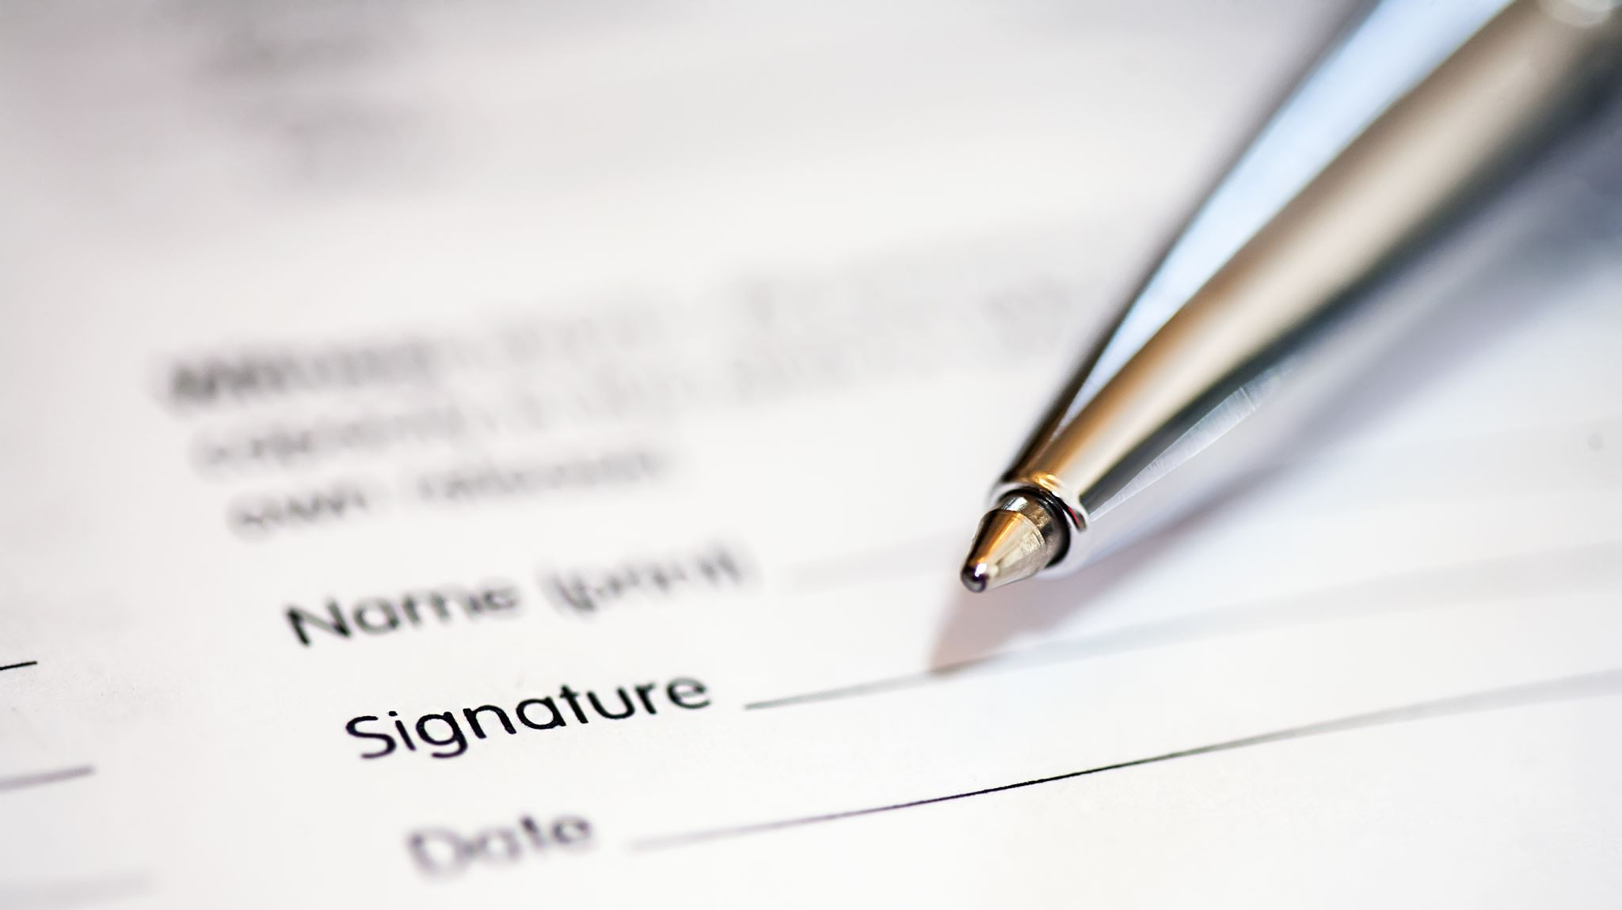
Syllabus Review Best Practices
Carol Kuper, Director of GT Pathways
Morgan Community College

Slide 3
Syllabus
Who looks at these thing? Who are our stakeholders.
Students, Administrators, Other 2 and 4 year colleges and universities around the US.
Baader-Meinhof Phenomenon or frequency bias
When repetition increases our perception that it’s the norm.
Do all student not read the syllabus? The 10% that ask us questions stick out in our minds, but there are far more students that do not ask us syllabus questions.
Why do they need to be uniform in appearance?
When reviewers from accreditation and other colleges/universities know where they are from.

Slide 4
Why Review?
History
In the fall of 2017, outside reviewers changed the requirements for our syllabi, so a new standardize syllabus was created.
Faculty volunteers created and vetted a process for a master template that was easy to download and work with. With the help of Jess, a master syllabi and a compliance form was created.
Accreditation
Guaranteed Transfer Compliance
CCCS Compliance BP -72
Internal MCC policies

Slide 5
Syllabus Process – Restarting in the Spring
Why master syllabus change? Most changes are due to broken links, updating phone numbers and personal, legal statements from the system office. All can not be delayed to a yearly update and need to happen when changes occur.
Where are the master syllabus? All masters, GT and CTE/Non-GT, can be found in the D2L site entitled GT Pathways Syllabi 01-31. Full-time faculty and leadership have access. Part-time faculty, please contact Carol Kuper, your division chairs, or Deans for a copy.
Notification of changes – Three notifications are sent each Fall and Spring semester. First a month before the semester ends, a week before the semester ends and a third notification before the syllabus deadline.
Syllabus deadlines are for EVERYONE no just GT. Carol Kuper does send out the notifications but changes and deadlines effect everyone.
See the end of this PowerPoint for current deadlines.

Slide 6
GT vs CTE/Non-GT
CTE/Non-GT
CCCS course approval process. Courses go through the state discipline chairs, a college curriculum committee, SFCC (State Faculty Curriculum Committee), and the Academic Council of VP’s.
Courses with no 3-digit code after the course title.
One master syllabus
Syllabi are sent to a general email address: syllabi@morgancc.edu
GT (Guaranteed Transfer) Courses
GT Courses have been through a rigorous process within CCCS and CDHE’s General Education Counsel.
GT courses have a 3-digit code after the course title. Example, College Algebra MA1. Due to specific GT statements connected to the code, all GT courses have different templates. GT codes: AH1, AH2, AH3, AH4, CO1, CO2, CO3, HI1, MA1, SC1, SC2, SS1, SS2, and SS3.
CDHE backend reviews for all 2- and 4-year colleges and universities on the first day of class. DEADLINES are critical, so we need to be prepared the first day of classes.
Full time faculty and administrators have access to a D2L shell with all 130+ Masters (updated website will open end of November)
Syllabi are sent to Carol Kuper: carol.kuper@morgancc.edu
Acronyms
GT (Guaranteed Transfer)
CCCS (Colorado Community College System)
SFCC (State Faculty Curriculum Committee)
CDHE (Colorado Commission on Higher Education)
GE (General Education)

Slide 7
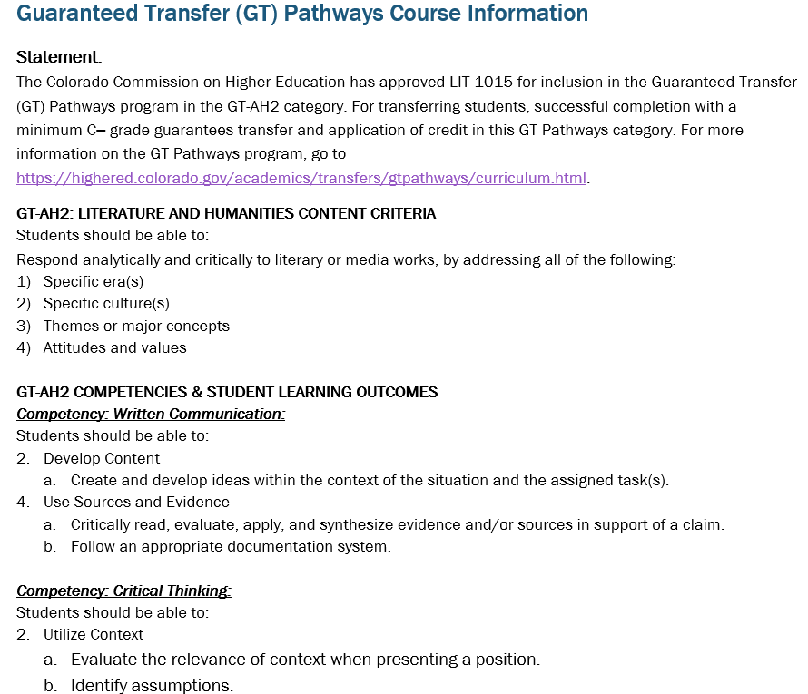
GT Section of the syllabus Example Only items that are different between GT and CTE/Non-GT Syllabi
GT courses have a 3-digit code after the course title. Example, College Algebra MA1. Due to specific GT statements connected to the code, all GT courses have a different template.

Slide 8
Best Practices to Modify a Master
Tip: Syllabus reviewers do not have access to your D2L, so syllabi must be sent into the emails on slide 6.
Tip: Be sure to delete all instructions in RED [] before submitting.
Tip: When entering information do not highlight the extra line below, so you will not have a formatting issue.
Tip: Your MCC Email must be used for communication with students.
Tip: Classroom etiquette/behavioral expectations will summarize classroom behavior regarding lab safety, food drink, etc.
Tip: Electronic policy will summarize the use of electronic devises (cell phones, laptops, tablets, etc) in the classroom.
Tip: Communication policy will summarize how students will reach you by phone or email.
Tip: Classroom Etiquette/Behavioral Expectations will inform students of the day-to-day classroom environment.
Tip: Academic Integrity Policy will define and address plagiarism policies and consequences.
Tip: If applicable, include a Zoom policy will summarize protocols and etiquettes for getting connected to the course.
Tip: The CRN number can be found in the Class Schedule and in Banner under the Detailed Schedule.

Slide 9
Common Mistakes – Try and avoid if possible.
Using the wrong master template
Incorrect course section number
First line example:
Incorrect CRN – Information can be found in the course schedule
Important dates are given via email for 15-week courses.
Ask Deans or I for alternative start dates.
Master Syllabus Language
Do Not change wording or tables in black font.
Do remove all place hold in Red or have [] around text
MAT 1240 1X1

Slide 10
Syllabus Review Flow Chart
3. Syllabus send back to faculty for corrections, if needed, or this step is skipped
4. Syllabus reviewed again for compliance, or this step is skipped
5. Faulty publish syllabi in D2L and give to students
1. Faculty submit syllabi for review
2. Reviewer checks for compliance
Modifications to the all master syllabi are made. The first notification to all faculty are made 4 weeks before the semester ends.
CTE/Non-GT Faculty
Send your syllabus to syllabi@morgancc.edu Questions ask the Instructional Office
GT Faculty
Send your syllabus to carol.kuper@morgancc.edu
Questions ask Carol Kuper

Slide 11
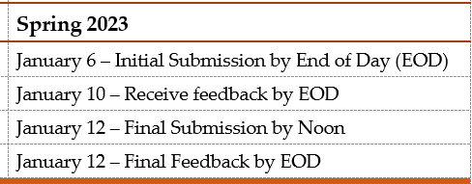
Spring 2023
Carol Kuper sends out reminder emails with deadlines and important dates for ALL faculty to follow.
MCC website has the important dates for every semester. Website: https://www.morgancc.edu/current-students/academic-calendar/
Deadlines

Slide 12
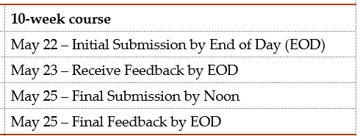
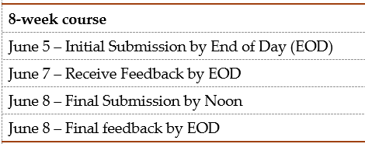
Summer 2023
Carol Kuper sends out reminder emails with deadlines and important dates for ALL faculty to follow.
MCC website has the important dates for every semester. Website: https://www.morgancc.edu/current-students/academic-calendar/
Deadlines

Slide 13
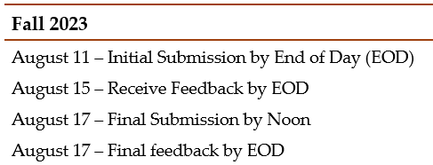
Fall 2023
Carol Kuper sends out reminder emails with deadlines and important dates for ALL faculty to follow.
MCC website has the important dates for every semester. Website: https://www.morgancc.edu/current-students/academic-calendar/
Deadlines

Slide 14
Thank you
Always here for ya.
Just email me to set up an appointment.
carol.kuper@morgancc.edu

